Slide 1
Documenting Quality Measures
Clinical Informatics
Clinical Informatics

Slide 2
Documenting Social History

Slide 3
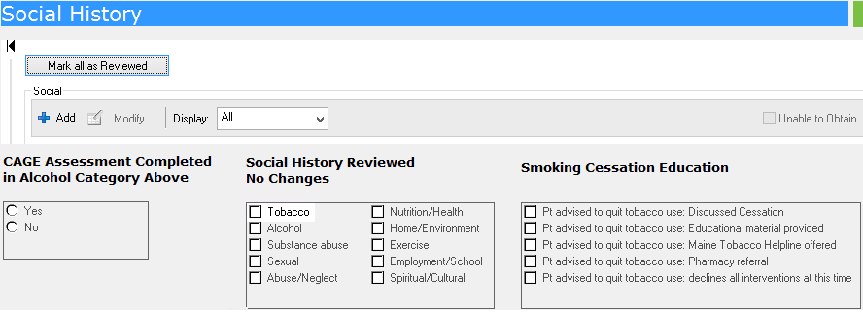
Social History – Mark All As Reviewed Button
Clinical staff must cease using the Mark all as Reviewed button when reviewing social histories and follow the new workflow detailed on the following slide.

Slide 4
Documenting Social History
Clinical staff verifying historically documented social history items, that have NO changes, now need to check off those items in the Social History Reviewed No Changes box.
Clinical staff should continue to document any new social history updates as normal using the Add button.

Slide 5
Smoking / Tobacco Assessment and Cessation

Slide 6
Documenting Patients Smoking Status
Smoking status on patients will now need to be updated once a year.
Clinical staff must document Smoking Cessation Education in the box below.

Slide 7
Hypertension Control

Slide 8
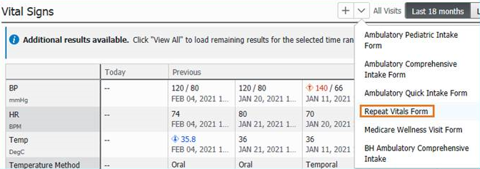
Documenting Repeat Vitals
Clinical staff can access the Repeat Vitals Form in the Vital Signs section dropdown arrow. This additional documentation can be used for hypertensive patients that need repeat blood pressures documented.

Slide 9
Medication History

Slide 10
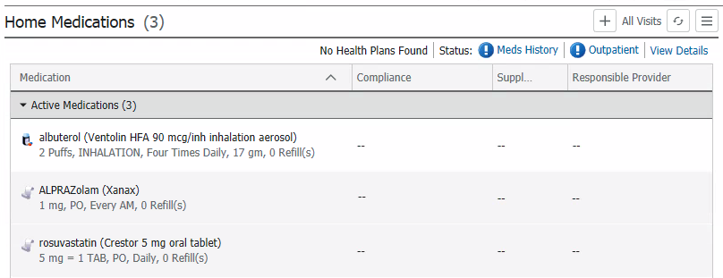
Documenting Patients Medication History
Clinical staff must verify/update/complete medication history for each patient visit.
- Clicking on the Meds History button will open the Document Medication by Hx tool.

Slide 11
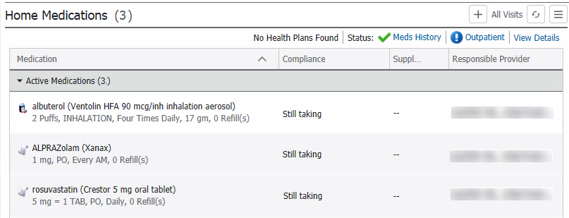
Documenting Patients Medication History
Clinical staff must include medication information on the last dose date/time, information source, and compliance, then click on Document History to satisfy this requirement.
This will update the Meds History with a green checkmark.

Slide 12
Medication Reconciliation

Slide 13
Documenting Patients Medication Reconciliation
Provider staff must complete medication reconciliation for each patient visit.
- Clicking on the Outpatient button will open the Order Reconciliation: Outpatient tool.

Slide 14
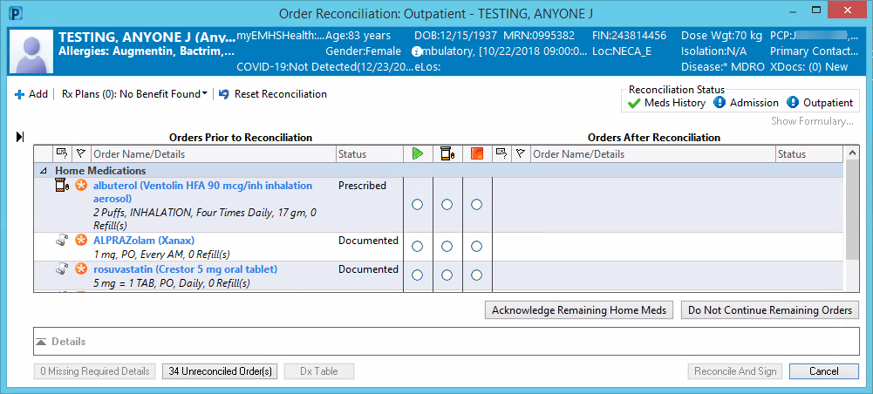
Documenting Patients Medication Reconciliation
In the Order Reconciliation: Outpatient tool, providers can indicate on each medication whether to continue, prescribe, or stop a medication, then Reconcile And Sign the reconciliation.
These actions will produce a green checkmark next to Outpatient.

Slide 15
Questions?

